Slide 1
Shoe shop on Flutter
Karim Zakirov, Ilya Maksimov, Alexander Gavovsky, Sergey Aitov (Team 4)

Slide 2
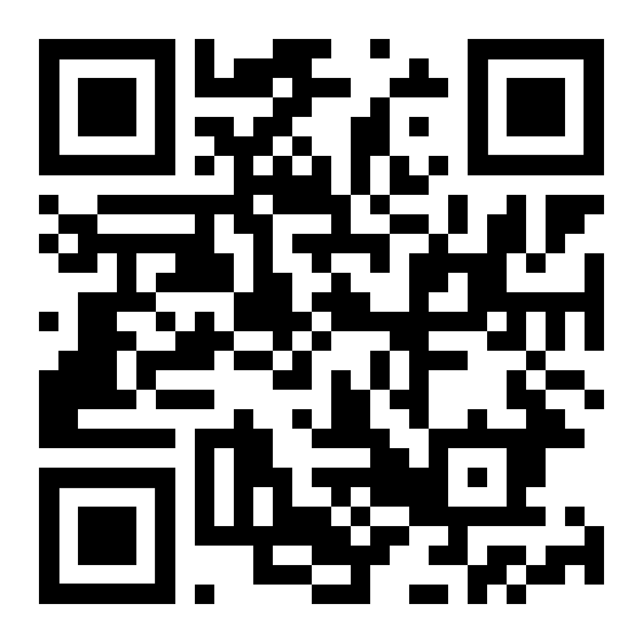
QR code to our GitHub repository

Slide 3
Problem

Slide 4
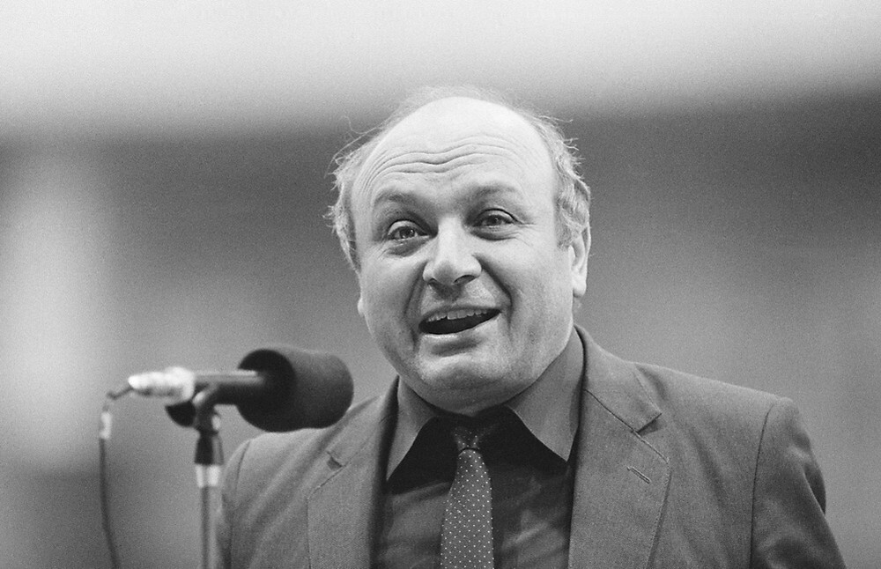
“Physical education prolongs life for five years, but these five years should be spent in the gym.”
©Mikhail Zhvanetsky

Slide 5
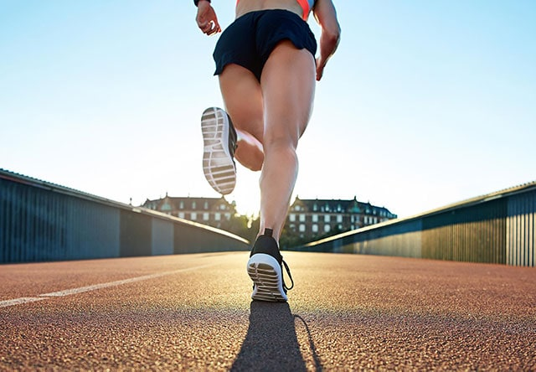
Problems of poor quality shoes
General problem: Improper distribution of the load on the feet.
Consequences:
flat feet
hallux valgus
heel spurs

Slide 6
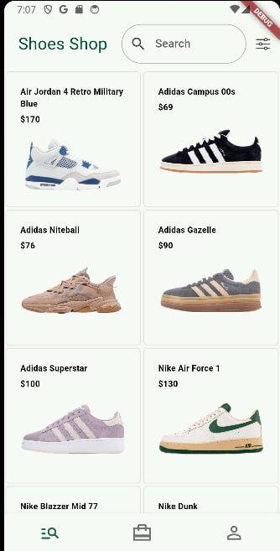
Shoe shop
Only sports-orientated footwear
Only quality footwear
Simple, clear design and interface

Slide 7
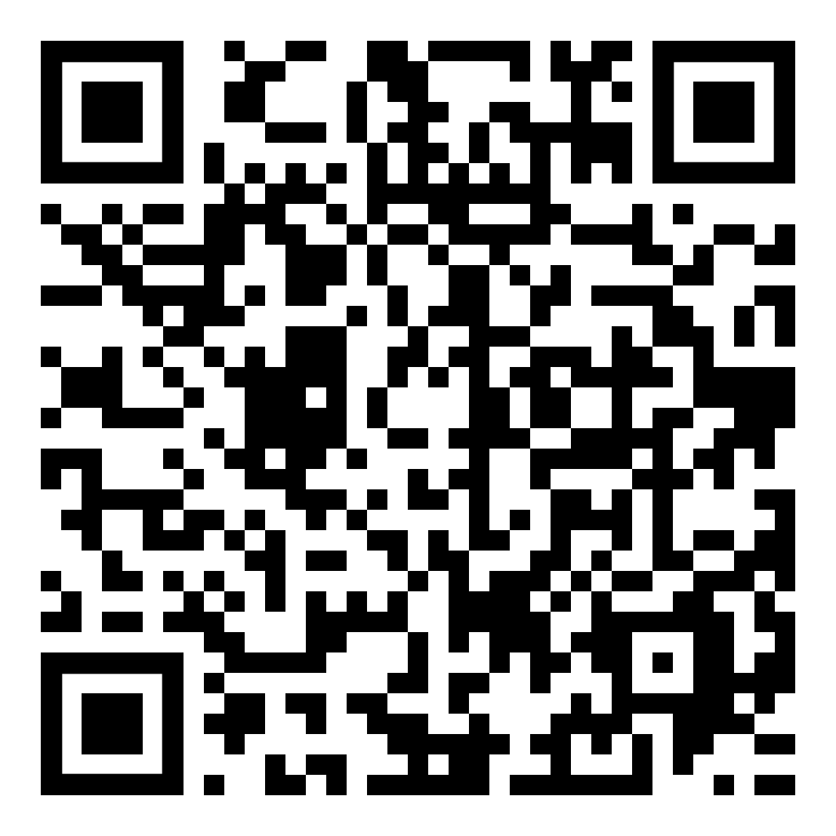
QR code for demo

Slide 8
Features

Slide 9
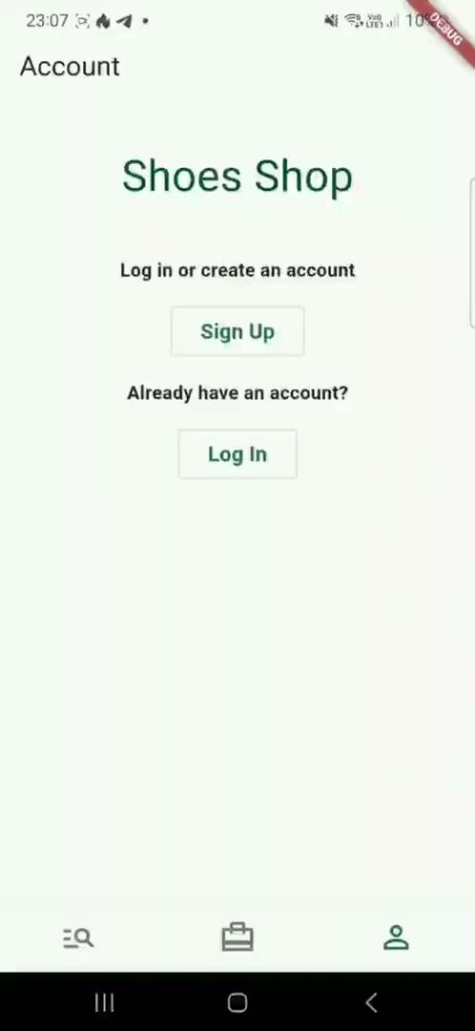
Login/Autorisation feature
The user is able to create an account and authorise using the Google system.

Slide 10
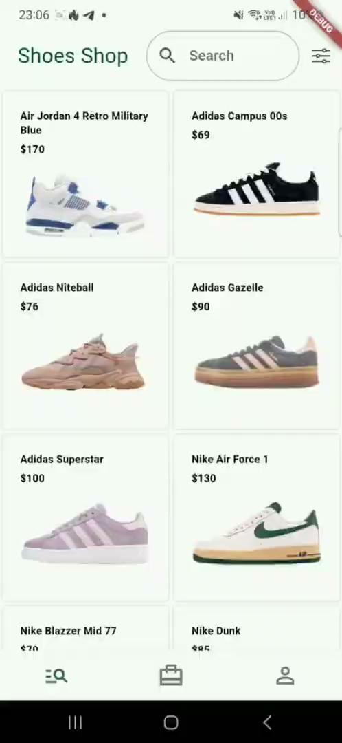
Filter feature
The user has the option to filter items by colour and brand.

Slide 11
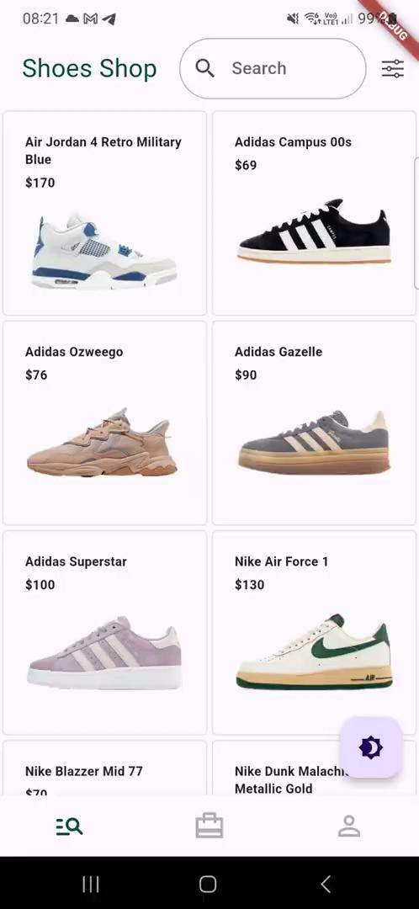
Adding to cart feature
The user has the option to add their favourite product items to the shopping cart.

Slide 12
Architecture Diagram

Slide 13
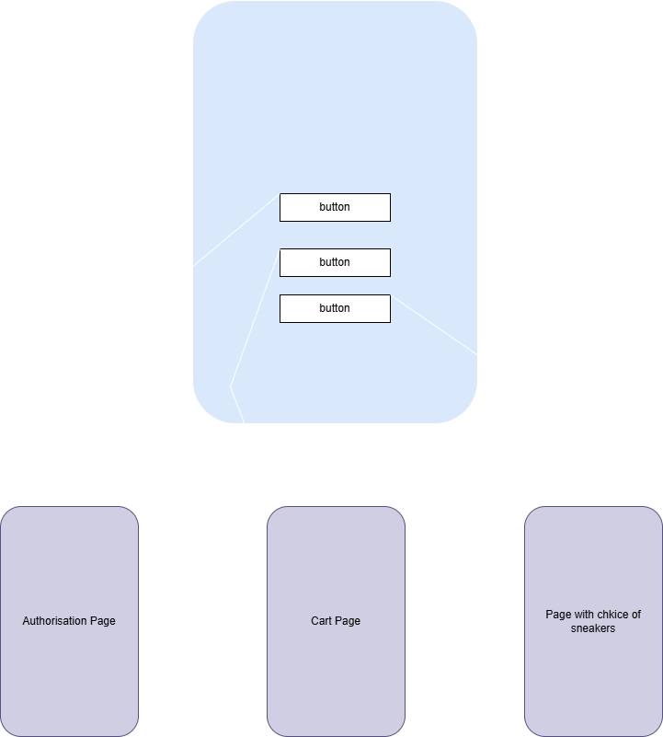

Slide 14
Challenges and Solutions

Slide 15
Problem with workflow customisation
Problem Description:
It was difficult to connect with all team members and assign tasks.
Solution:
Use of SCRUM system (instead of a table, tasks were distributed in a telegram).

Slide 16
Configuring the database for authorisation
Problem Description:
It was unclear how to link the shopping cart and the user.
Solution:
With the help of a lot of outside sources, got to figure out how to set this up.

Slide 17
Failed to set up CI/CD pipelines
Problem Description:
There was an error with different versions of dart SDK.
Solution:
Due to time constraints, we were unable to correct this error.

Slide 18
Thank you for your attention!

